Slide 2
Forces and Newton’s Laws of
Motion
How Pushes and Pulls Affect Motion

Slide 3
The Principia
In 1687 Isaac Newton published a large body of knowledge in which several laws are set forth. Some of these laws govern an area that has come to be known as classical mechanics or Newtonian mechanics. The laws governing mechanics have been steadfastly true for 300+ years for all bodies except atomic particles.

Slide 4
Newton’s first area of observation was the orbits of planets around the sun. He was able to mathematically establish that the sun must attract the planets with a relationship:
F_{attraction} is proportional to 1/r². where r is the distance between the sun and a planet. There are many relationships that are based upon this inverse Squared relationship. One offshoot of this is the Universal Law of Gravitation, which governs the attractive forces of two bodies in space.

Slide 5
Newton was able to determine that the attractive force between two bodies was equal to the product of their masses divided by the square of the distances between their centers, all multiplied by some constant
F = G m₁m₂
r²
This is among many postulates and laws put forth in the Principia.

Slide 6
For us, there is really only one part of the Principia which is of concern. Newton’s Laws of motion cover how objects behave when in motion. Newton’s ideas helped to shape the Age of Enlightenment and his thoughts on mechanics are the foundation of introductory physics studies worldwide.

Slide 7
Forces
Commonly, a force is a push or a pull. Falling objects are “pulled” by gravity. Forces, however, do not always cause motion. (A book sitting on a table).
Forces have magnitude and direction and are therefore vector quantities. The Net Force is the vector sum of all forces acting on an object simultaneously. It is also called the resultant force.

Slide 8
Forces are usually measured by use of a spring scale which is really the calibrated stretch of a spring. While the most common forces are of this variety, contact forces, they are not forces that are termed Fundamental. Fundamental forces are “action at a distance” forces. There are four fundamental forces.
Gravitational
Electromagnetic (static electricity, ionic bonds
Strong Force- holds nuclei together
Weak force

Slide 9
Inertia and Newton’s First Law
Inertia is a property of matter that resists changes in motion. More massive objects have more inertia; they are harder to start moving as well as harder to stop moving.
The Law- “ A body has a constant velocity unless there is a net force acting upon it.”
Also stated: A body in motion tends to stay in motion while a body at rest tends to stay at rest.

Slide 10
Newton’s Second Law- Momentum
The rate of change in momentum over time is proportional to the net applied force and is in the same direction.
F = Δ momentum
Δt
Momentum is the product of mass and velocity
F = m Δv ; F= (m)(a) because Δv = a
Δt Δt

Slide 11
Using F = (m)(a) we can predict the motion of an object if we know all the forces acting upon it.
The standard unit of force is called a Newton, and it is the amount of force required to accelerate a 1.0 kg mass at a rate of 1m/s². 1 N = 1kg●m/s²

Slide 12
A prospector pushes a 2030 kg mine cart with a force of 700. N. Find the acceleration of the cart.
F = ma a = 0.34 m/s²

Slide 13
When the acceleration experienced by the object is that of gravity, then the Force is given a special name, Weight.
F_{w} = (m)(g)
If a car has a weight of 2200N, what is its mass.
F_{w} = (m)(g)
2200 N = m = 224 kg
9.8m/s²

Slide 14
Even an object sitting on the ground will have acceleration of gravity pulling it downward. Because the object is motionless, not accelerating, there must be no Net Force acting upon it. This means there must be an upward force opposing the acceleration due to gravity. This is an example of Newton’s Third Law- for every action there is an equal and opposite reaction. When the object pushes on the ground, the ground pushes back with the same force.

Slide 15
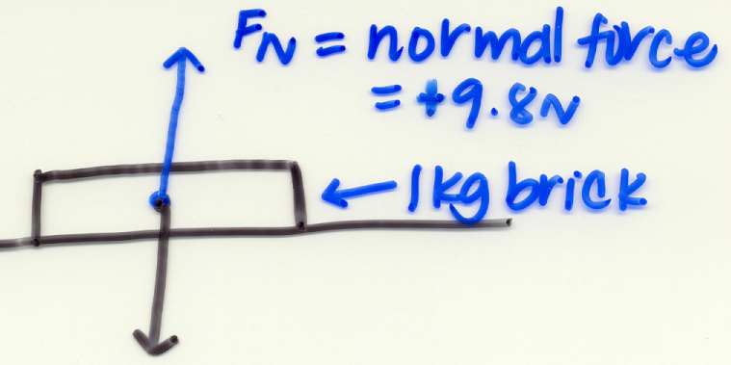
This opposing force is called the Normal force and it will act perpendicular to the surface on which the object rests.

Slide 16
When pushing or pulling, we must often resolve applied forces into components to find the part of the force that is actually being applied to an object to cause acceleration.
A rope is attached to a 25 kg cart. If the rope is pulled with a force of 100 N at an angle of 35° above the horizontal, what is the acceleration of the cart.

Slide 17
